Slide 1

Home Picing Estimation
Reducing Asymmetric Information in
the Dutch Real Estate Market

Slide 2



The Selling Process
Depencency on Real Estate Brokers
Exchange of goods

Slide 3




The Selling Process
Depencency on Real Estate Brokers
Real Estate Broker
Selling Price
Fees are dependent
on selling price
Exchange of goods

Slide 4
The Selling Process
Depencency on Real Estate Brokers
Real Estate Broker
Real Estate Broker
Buying Price
Selling Price
Fees are fixed
Fees are dependent
on selling price
Exchange of goods

Slide 5
The Selling Process
Depencency on Real Estate Brokers
Collusion?
Real Estate Broker
Real Estate Broker
Buying Price
Selling Price
Fees are fixed
Fees are dependent
on selling price
Exchange of goods

Slide 6



Improving the Sellers’ position
Reducing the need for a broker
Real Estate Broker
€€€
Expertise on
housing pricing
Provides assistance
with viewings
Connections with
other brokers
Arranges sell
contract
(1) http://homeguides.sfgate.com/out-estimated-value-house-6876.html

Slide 7
Improving the Sellers’ position
Reducing the need for a broker
Real Estate Broker
Source of asymmetric information
€€€
Real estate professionals have access to industry databases with much more complete and recent data (1)
Expertise on
housing pricing
Provides assistance
with viewings
Create new dataset for sellers
Connections with
other brokers
Arranges sell
contract
(1) http://homeguides.sfgate.com/out-estimated-value-house-6876.html

Slide 8

Scraping Methodology
Giving sellers access to market information
Scraping “Funda”
A Dutch Real Estate website that contains 80% of the houses on the market (1)
(1) https://www.emerce.nl/nieuws/concurrenten-funda-winnen-marktaandeel
Vraagprijs ~ 0 + Woonoppervlakte + Perceeloppervlakte + `Soort woonhuis` + VolledigIsolatie + `Aantal badkamers`+ Aantal woonlagen` + `Soort parkeergelegenheid` + Ligging + Tuin + Adress, data = HouseInformation

Slide 9
Scraping Methodology
Giving sellers access to market information
Scraping “Funda”
A Dutch Real Estate website that contains 80% of the houses on the market (1)
Beautifulsoup with I.P. Rotation
Scraping a weppage in 0.8 sec
Changing the I.P. adress every 200 pages
Using the TOR network with 7000 proxies
Retrieved 72000 observations with 35 variables
(1) https://www.emerce.nl/nieuws/concurrenten-funda-winnen-marktaandeel
Vraagprijs ~ 0 + Woonoppervlakte + Perceeloppervlakte + `Soort woonhuis` + VolledigIsolatie + `Aantal badkamers`+ Aantal woonlagen` + `Soort parkeergelegenheid` + Ligging + Tuin + Adress, data = HouseInformation

Slide 10
Scraping Methodology
Giving sellers access to market information
Scraping “Funda”
A Dutch Real Estate website that contains 80% of the houses on the market (1)
Beautifulsoup with I.P. Rotation
Scraping a weppage in 0.8 sec
Changing the I.P. adress every 200 pages
Using the TOR network with 7000 proxies
Retrieved 72000 observations with 35 variables
OLS Model to predict House Price
10 Variables
R² of 0.87
White’s Standard Errors to correct for Heteroskedastic residuals (Gauss Markov Assumptions)
(1) https://www.emerce.nl/nieuws/concurrenten-funda-winnen-marktaandeel
Vraagprijs ~ 0 + Woonoppervlakte + Perceeloppervlakte + `Soort woonhuis` + VolledigIsolatie + `Aantal badkamers`+ Aantal woonlagen` + `Soort parkeergelegenheid` + Ligging + Tuin + Adress, data = HouseInformation

Slide 11
Scraping Methodology
Giving sellers access to market information
Scraping “Funda”
A Dutch Real Estate website that contains 80% of the houses on the market (1)
Beautifulsoup with I.P. Rotation
Scraping a weppage in 0.8 sec
Changing the I.P. adress every 200 pages
Using the TOR network with 7000 proxies
Retrieved 72000 observations with 35 variables
OLS Model to predict House Price
10 Variables
R² of 0.87
White’s Standard Errors to correct for Heteroskedastic residuals (Gauss Markov Assumptions)
Shiny Application
Giving sellers access to the data
Allowing them to estimate the selling price of
their house.
(1) https://www.emerce.nl/nieuws/concurrenten-funda-winnen-marktaandeel
Vraagprijs ~ 0 + Woonoppervlakte + Perceeloppervlakte + `Soort woonhuis` + VolledigIsolatie + `Aantal badkamers`+ Aantal woonlagen` + `Soort parkeergelegenheid` + Ligging + Tuin + Adress, data = HouseInformation

Slide 12
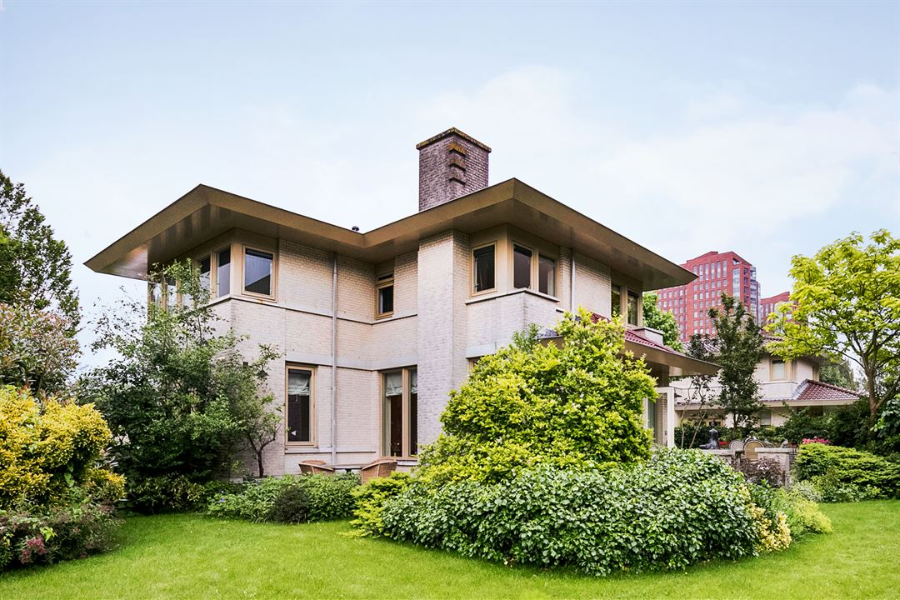

Shiny Application
Allowing for individual house pricing
House Details:
“Out of sample”
Type of house: Villa
Zipcode: 2905
Surrounding: Quiet road
Living area: 230 m²
Land area: 1007 m²
Garden type: Around the house
Number of floors: 2
Number of bathrooms: 2
Insulated: Yes
Parking options: Parking Garage
Model Estimated Price: € 905,339
Acutal Asking Price: € 895,000
http://www.funda.nl/koop/capelle-aan-den-ijssel/huis-49245150-s-gravenweg-365/

Slide 13
Improving the Seller’s position
Some conclusions
Giving sellers access to market information and reduces asymmetric information
Reduces the need for real estate brokers and thereby reduces the cost when you sell your house
Creates an insentive for real estate borkers to focus on service, instead of monopolizing their private market information

Slide 14
Home Picing Estimation
Reducing Asymmetric Information in
the Dutch Real Estate Market
Thank you for your attention
Are there any questions?

